Slide 1
Workshop 3 – Support Vector Machines
Advanced Analytics and Applications [AAA]
Information Systems for Sustainable Society (is3) | WiSo Faculty | Univ.-Prof. Dr. Wolfgang Ketter | 4/21/20

Slide 2
Administration
Reminder: Form Teams!!!
Form teams of people by next Wednesday (April 22, 2020). You can use the Ilias forum or Slack to find potential group members.
Each group should nominate a contact person which is responsible for the communication with us (e.g., teaching assistant).
This contact person of each group needs to send me an e-Mail by April 22, 2020 (noon) with a list of all team members (name, surname, matriculation ID), a creative team name, and please highlight the name of the contact person.
Especially the topics Kernel Machines, Clustering, Spatial Analytics and Deep Learning should be used by you to successfully complete the team project.
The detailed team project description will be announced at the end of the month (April 29, 2020) via Ilias and/or e-Mail..

Slide 3
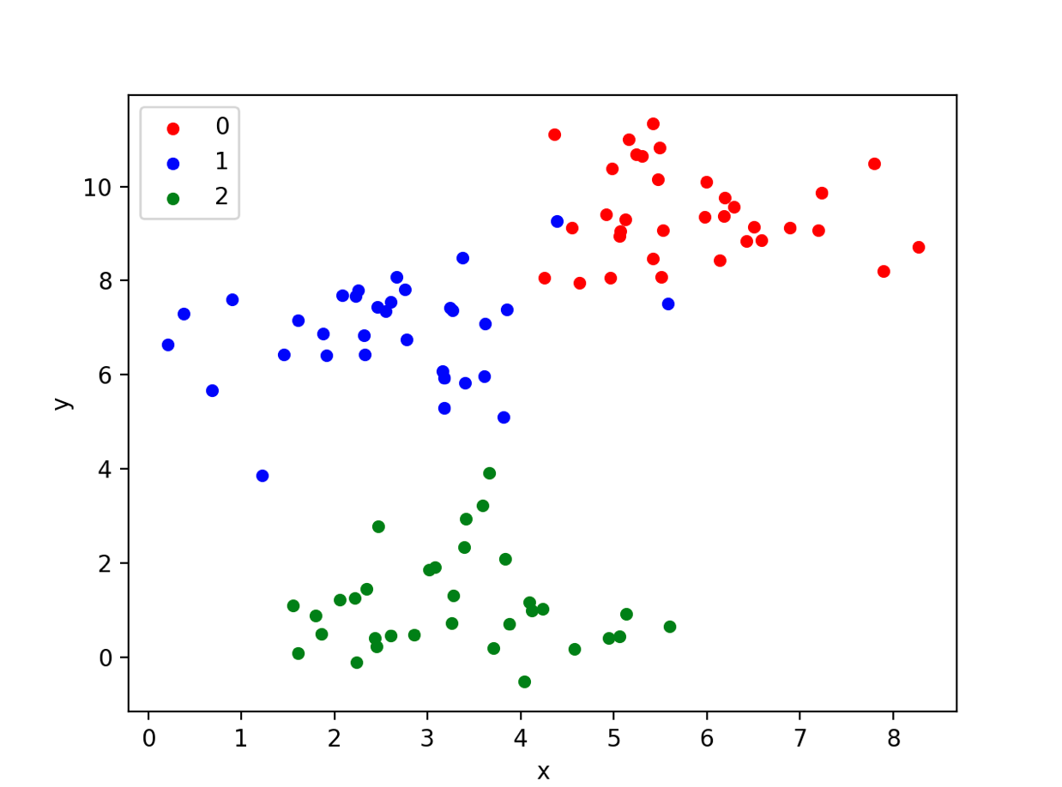
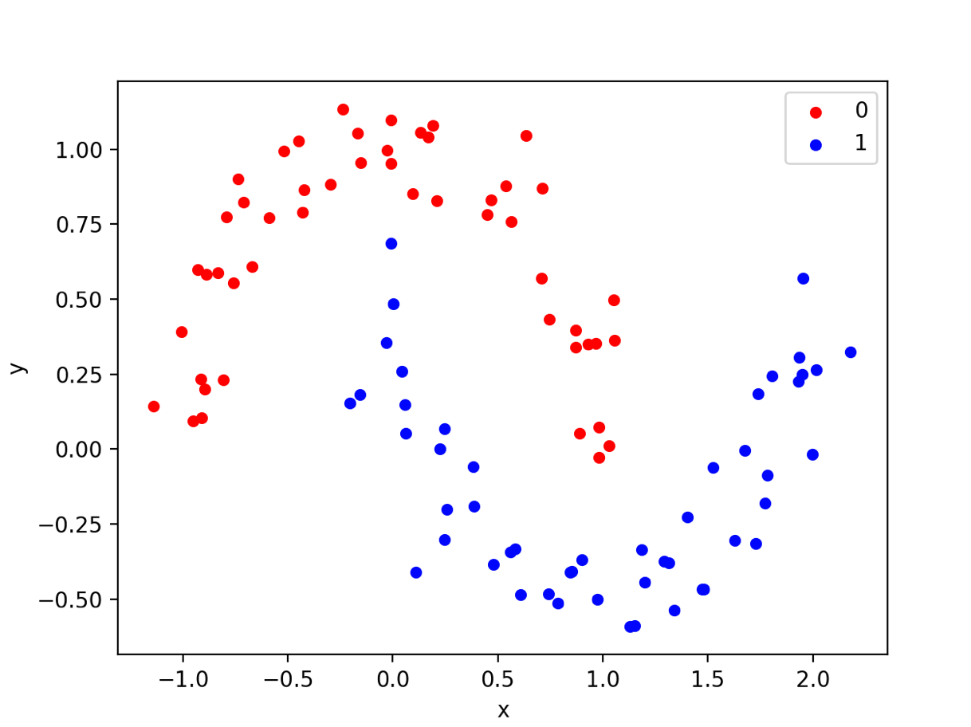
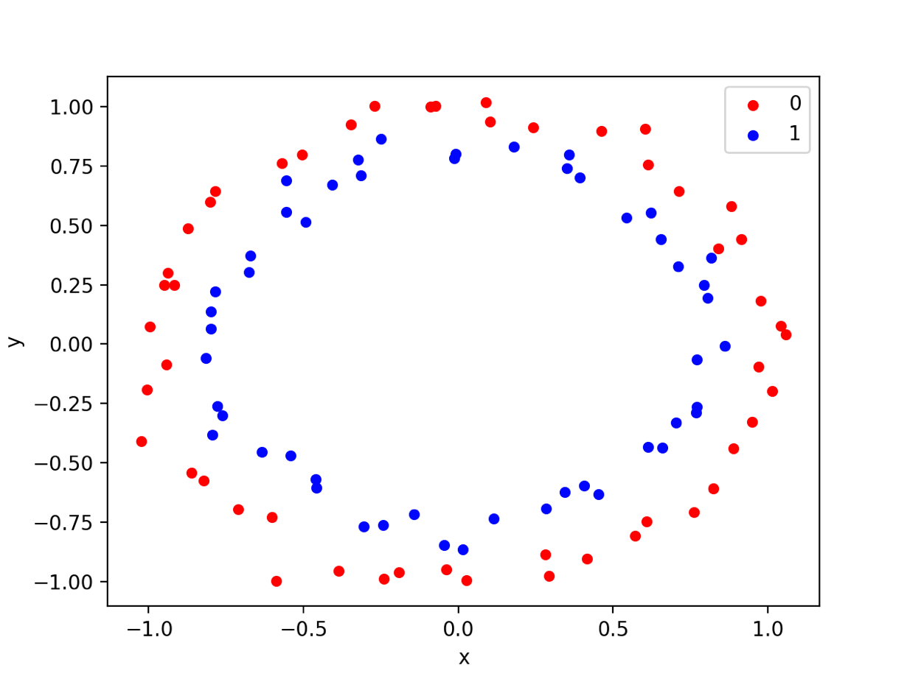
Recap: Kernel Machine Lecture
Generating Toy Data according to our needs

Slide 4
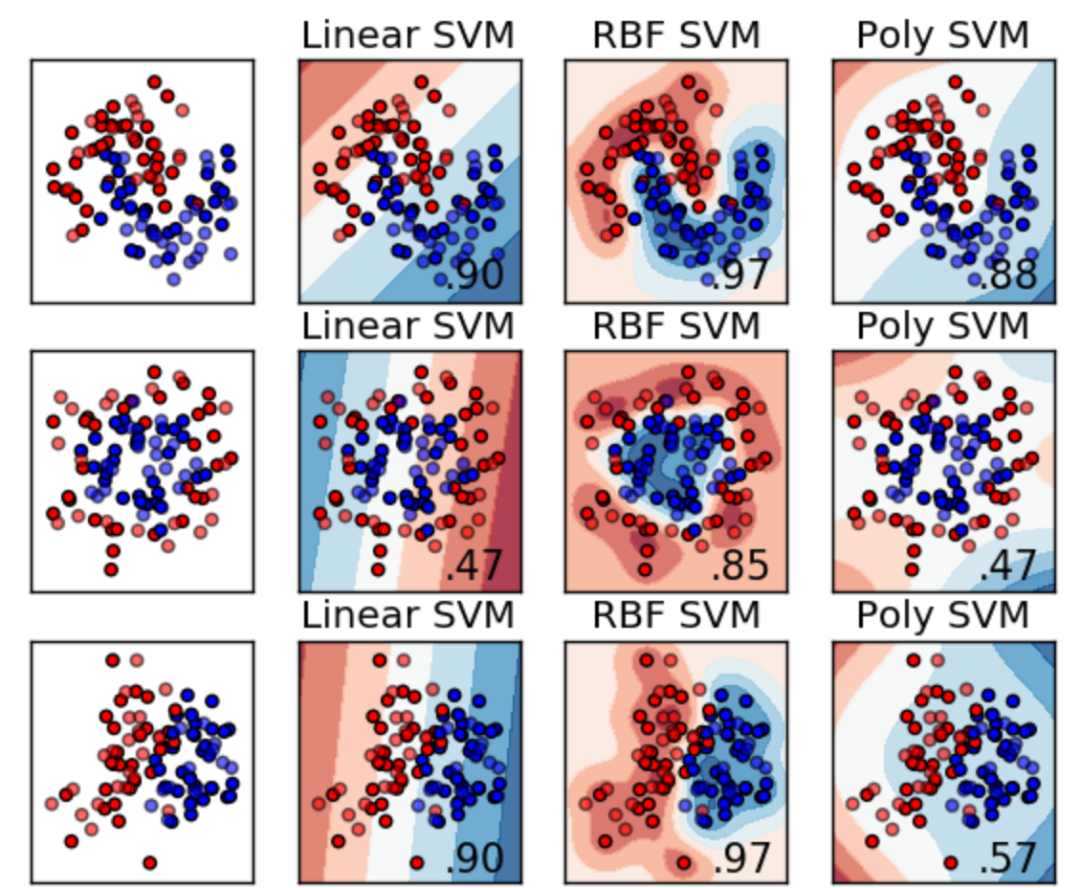
Recap: Kernel Machine Lecture
Support Vector Machines

Slide 5
Contact
For general questions and enquiries on research, teaching, job openings and new projects refer to our website at www.is3.uni-koeln.de
For specific enquiries regarding this course contact us by sending an email to the IS3 teaching address at is3-teaching@wiso.uni-koeln.de

